Slide 1
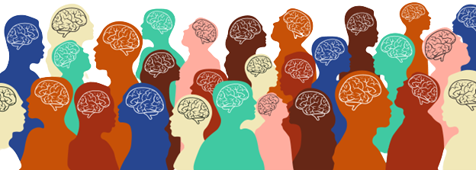
NEURODIVERSITY &
FAMILIES
Notes:
Hi my name is Lyndi Bradley… I work at FSU….
Before we begin, I would like to take a moment and try to make a connection to your daily work. Is there someone that comes to mind when we discuss neurodiversity? This could be a client, a family member, a friend… What do you know about this person? Their personality, skills, abilities, etc.
Can you go a head and think of some ways you might be able to implement some of this knowledge in your work?
I would like you all to keep these ideas in mind as we go through this information.

Slide 2
Objectives
Discuss a few different types of neurodiversity
Understand two models of viewing disabilities
Examine the different needs of neurodivergent children and individuals
Learn ways to support children and families in your role

Slide 3
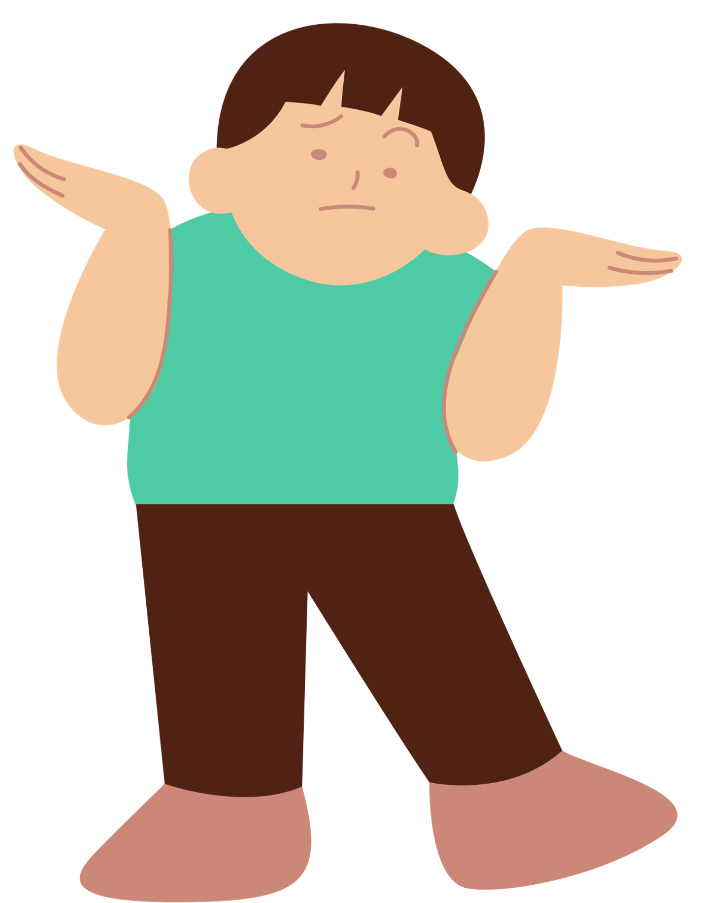
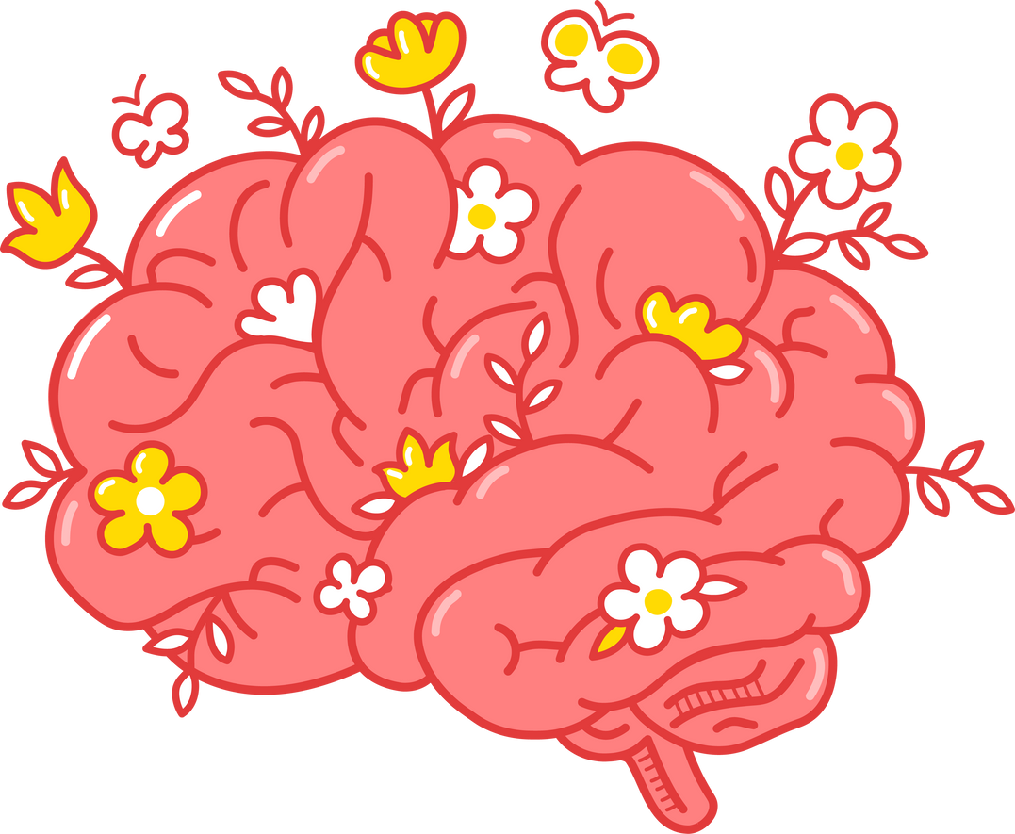
What is Neurodiversity?
Neurodiversity explains the variation of cognitive functioning in people.
Individuals have unique brains, therefore, making people unique in their
Skills
Abilities
Needs
The way that people experience and interact in the world

Slide 4
TERMS TO KNOW
Neurodiversity is the idea that it is normal and acceptable for people to have different brains from the norm.
People whose brain processing and function vary from the norm are considered neurodivergent.
A person who has the standard brain processing and functioning is considered neurotypical.

Slide 5
THE DIVERSITY OF ONE'S COGNITIVE ABILITIES CAN HAVE AN IMPACT ON AN INDIVIDUAL'S:
It is important to note that when understanding neurodiversity there is not one normal or healthy type of brain.
Socializing
Attention
Learning
It is just a normal variation of cognitive functioning in the human population, as there is no one correct way of thinking and processing the world.
Moods & Emotions
Behavior

Slide 6
Neurodiversity looks to change how society views disorders relating to the brain and remove the negative stigmas associated with such conditions. Neurodiversity aims to demonstrate that brain differences are not errors that must be fixed; neurodivergent individuals have strengths too!

Slide 7
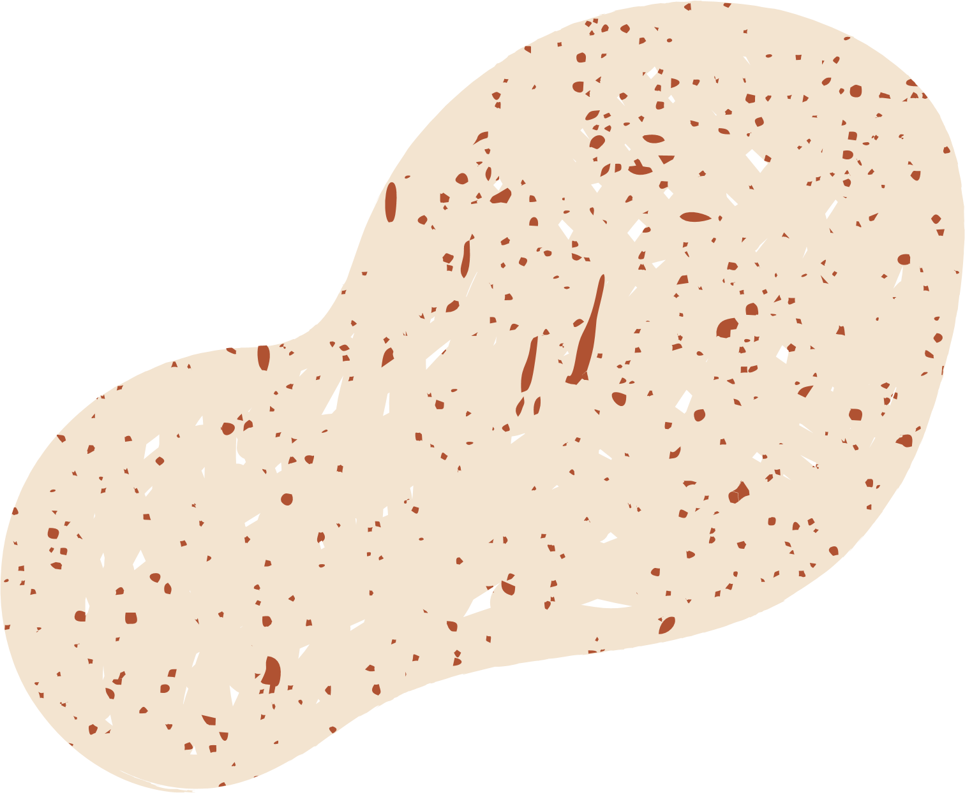
TYPES OF NEURODIVERSITY
Hyperlexia
Dyslexia
Dyspraxia
Autism
ADHD/ADD
Dyscalculia
Tourette Syndrome

Slide 8
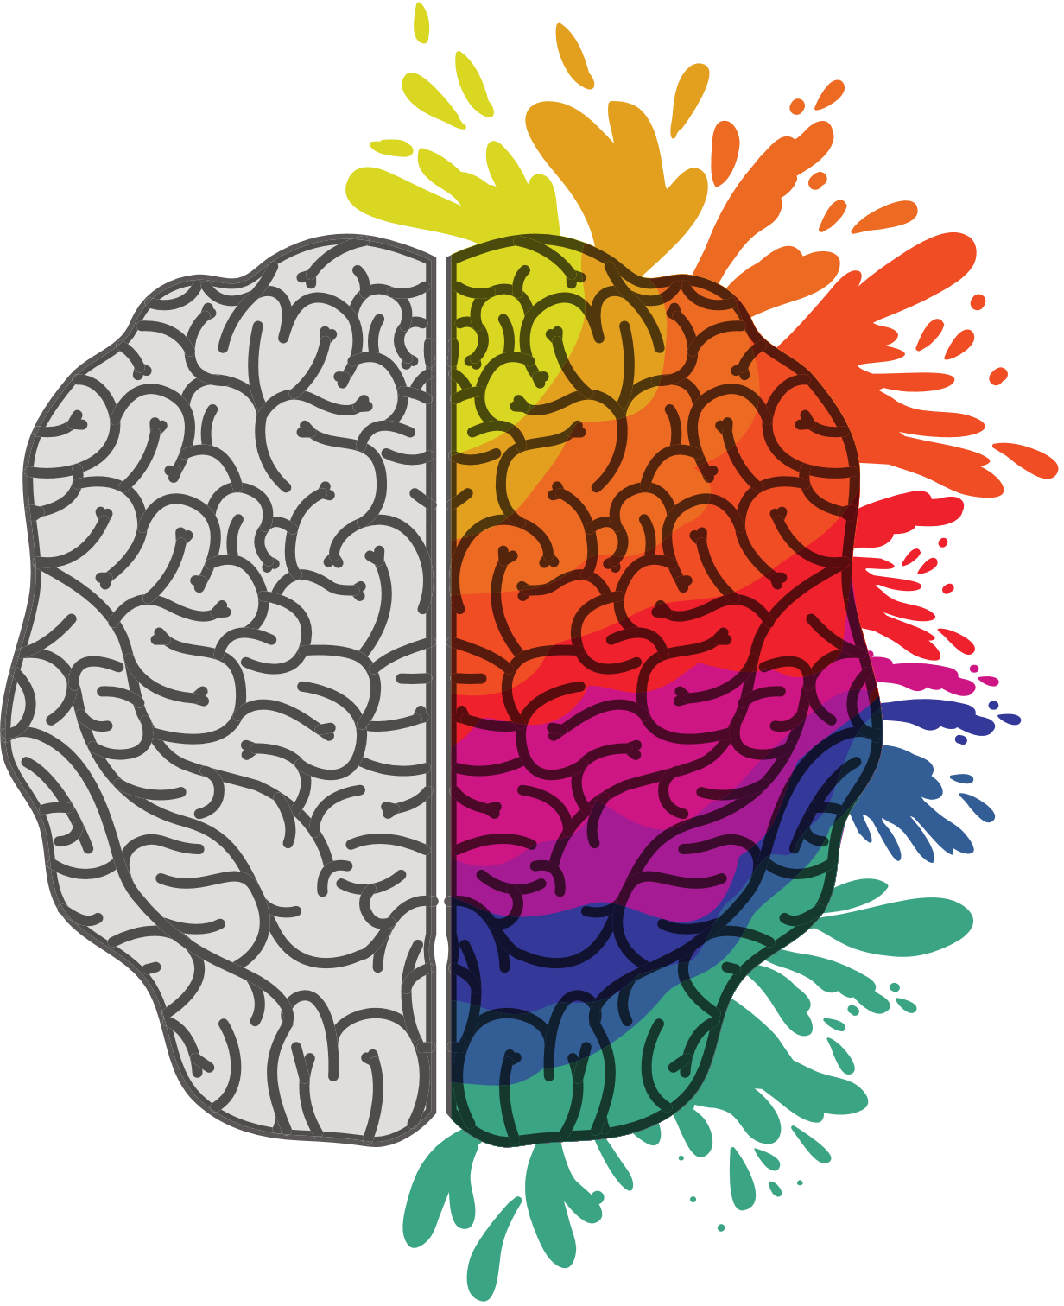
Autism Spectrum Disorder
ASD is a developmental disability that affects a child’s ability to socialize, communicate, and behave (CDC, 2020).
Children in the spectrum show signs of ASD from as young as 18 months.
About 1 in 54 children have been diagnosed with ASD (CDC, 2020).
Notes:
ASD is diagnosed more commonly in boys than girls by four times.

Slide 9
CHILDREN WITH ASD MAY:
Avoid eye contact
Repeat actions, behaviors, and words/phrases consistently
Have difficulty with changes in their life such as disruptions to their everyday routines
Have delayed language skills
Fixate towards specific objects or activity
Have difficulty recognizing others’ feelings, nonverbal cues, and interpreting them
(Mayo Clinic, 2018)
Although ASD is a lifelong condition, it is treatable with several interventions. Treatment plans typically include a multidisciplinary approach involving occupational therapists, behavioral therapists, speech therapists, etc. (CDC, 2019)

Slide 10
Hyperlexia
Hyperlexia is the incredible ability to read at a surprisingly early age.
Typically falling under the category of ASD, children with hyperlexia may lack other skills, such as communication and social, due to their fixation with letters.

Slide 11
ADHD/ADD
Individuals with ADHD/ADD exhibit difficulty paying attention, staying focused, and having less control over their behaviors and emotions.
Notes:
Attention Deficit Hyperactivity Disorder (ADHD) is a common disorder during childhood.
Children with ADHD typically have trouble paying attention, controlling their behavior, and can be overly active.

Slide 12
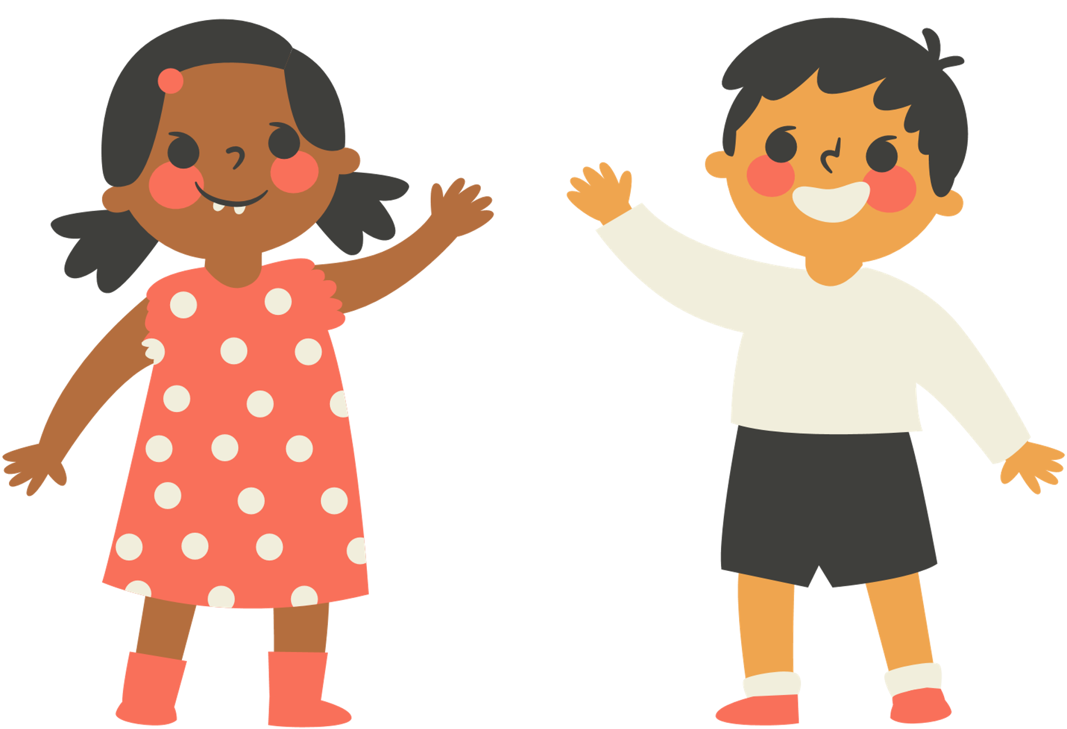
Some Symptoms of ADHD include:
Daydreaming frequently
Fidgeting
Easily distracted
Forgetting to complete tasks
Boys who have ADHD tend to be more hyperactive than girls who tend to be more inattentive (Mayo Clinic).
Notes:
ADHD is more likely to be diagnosed in boys than girls.
Boys who have ADHD tend to be more hyperactive than girls who tend to be more inattentive (Mayo Clinic).
Treatment for children with ADHD may include medication in conjunction with behavioral therapy sessions.

Slide 13
Dyspraxia
Dyspraxia is the difficulty in controlling motor coordination.
Affects 5-10% of the population
Usually is seen in the early development stages (DSM-5)
Notes:
Dyspraxia (also called Developmental Coordination Disorder or DCD) is a neurodevelopmental disorder that affects an individual's coordination and motor skills.
Affects 5-10% of the population
Boys are twice as likely to be diagnosed than girls
And is usually seen in the early development stages according to the DSM-5

Slide 14
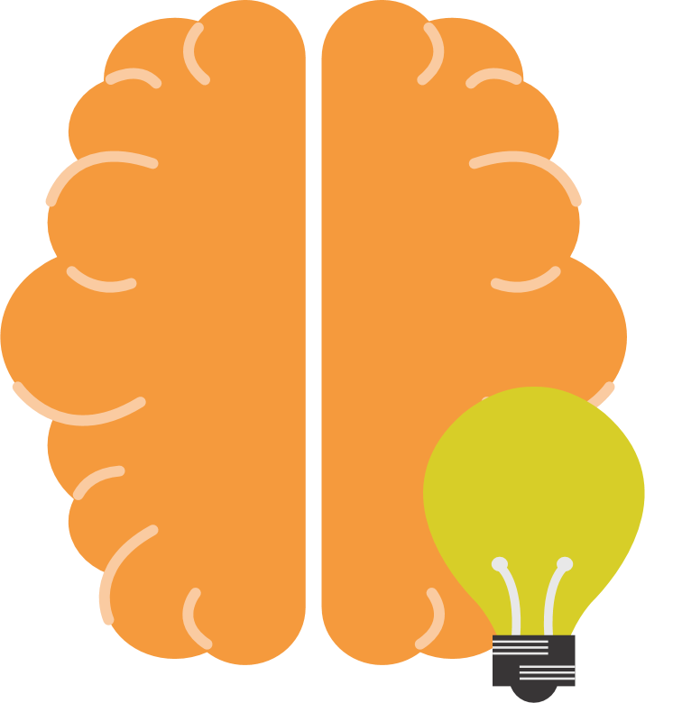
DYSPRAXIA
Activities like playing sports, biking, skiing, and driving may be affected.
However, it does not affect one's intelligence, cognitive ability, and analytical skills.
With practice, children can master activities that require coordination and increased motor skills such as writing, riding a bike, or tying a shoelace (Miller, 2021).
Notes:
Physical activities like playing sports, biking, skiing, and driving may be affected.
However, it does not affect one's intelligence, cognitive ability, and analytical skills.
There is currently no cure for Dyspraxia but interventions such as physical therapy and occupational therapy exist to help children improve and manage their symptoms.
With practice, children who have DCD can master activities that require coordination and increased motor skills such as writing, riding a bike, or tying a shoelace (Miller, 2021).

Slide 15
Dyslexia
Dyslexia is a learning disorder that involves difficulty in reading due to problems identifying speech sounds and connecting the sounds to letters and words (Mayo Clinic, 2017)
Affects 20% of the population,
The most common learning disability,
Typically diagnosed when children begin school and start learning how to read
(The Yale Center for Dyslexia and Creativity).

Slide 16
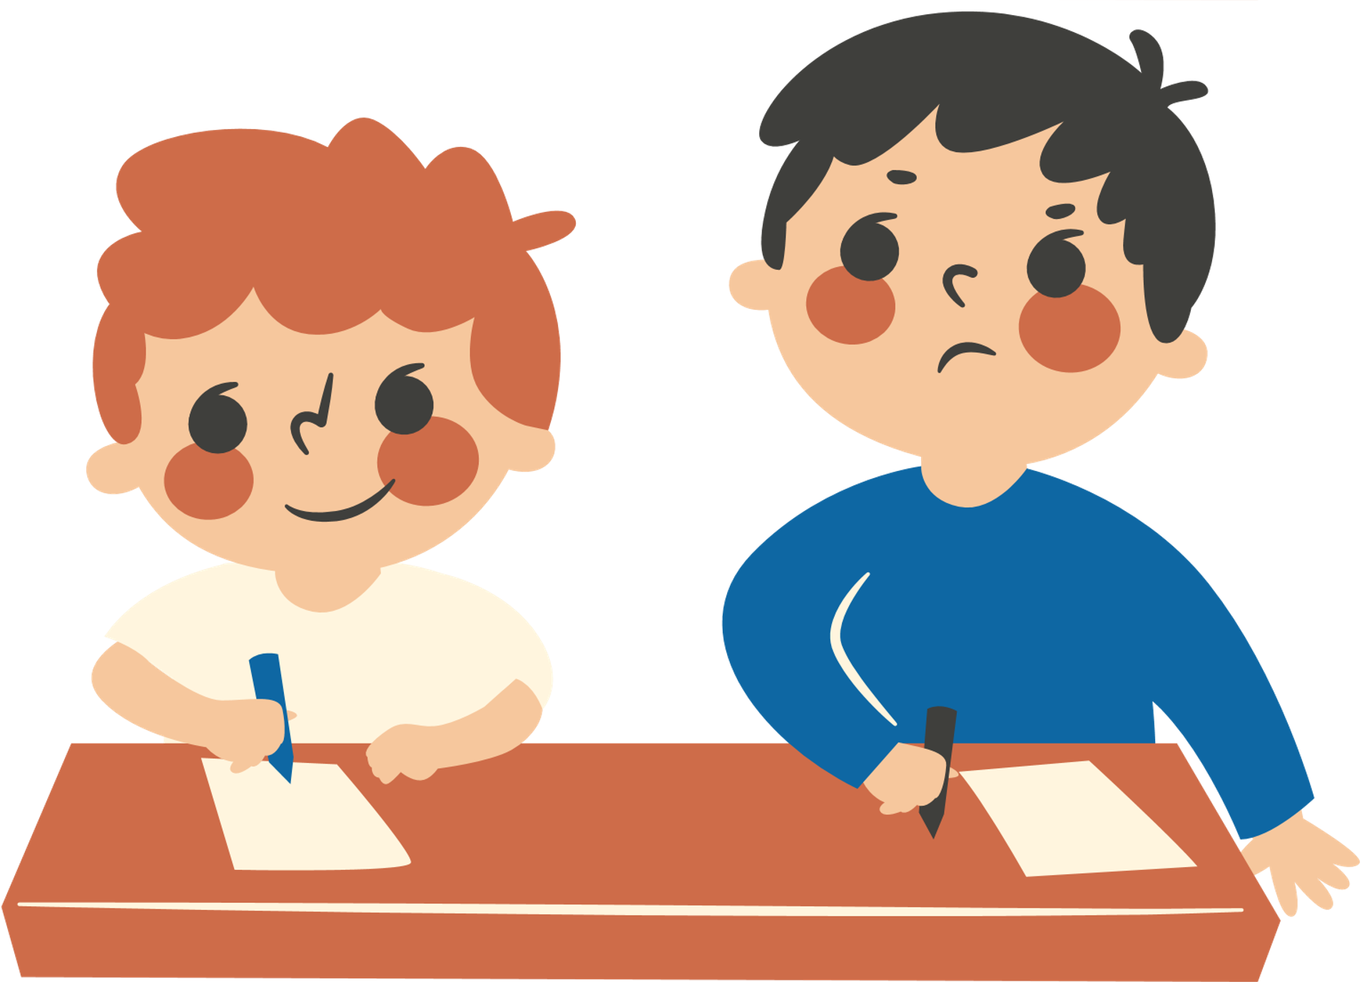
SIGNS A CHILD MAY HAVE DYSLEXIA INCLUDE:
Having difficulty learning and remembering the name of letters in the alphabet
Reading at a slower pace
Confusing letters that look or sound similar
Having trouble breaking up the word and separating the individual sounds in the word
Treatment for dyslexia involves:
Multisensory teaching (using sight, sound, movement, and touch to help kids connect language to words)
Getting an Individualized Education Program (IEP) or a 504 Plan for accommodation at school
Notes:
Dyslexia usually persists throughout the child’s life. There is no known cure for dyslexia. However, dyslexia is treatable.

Slide 17
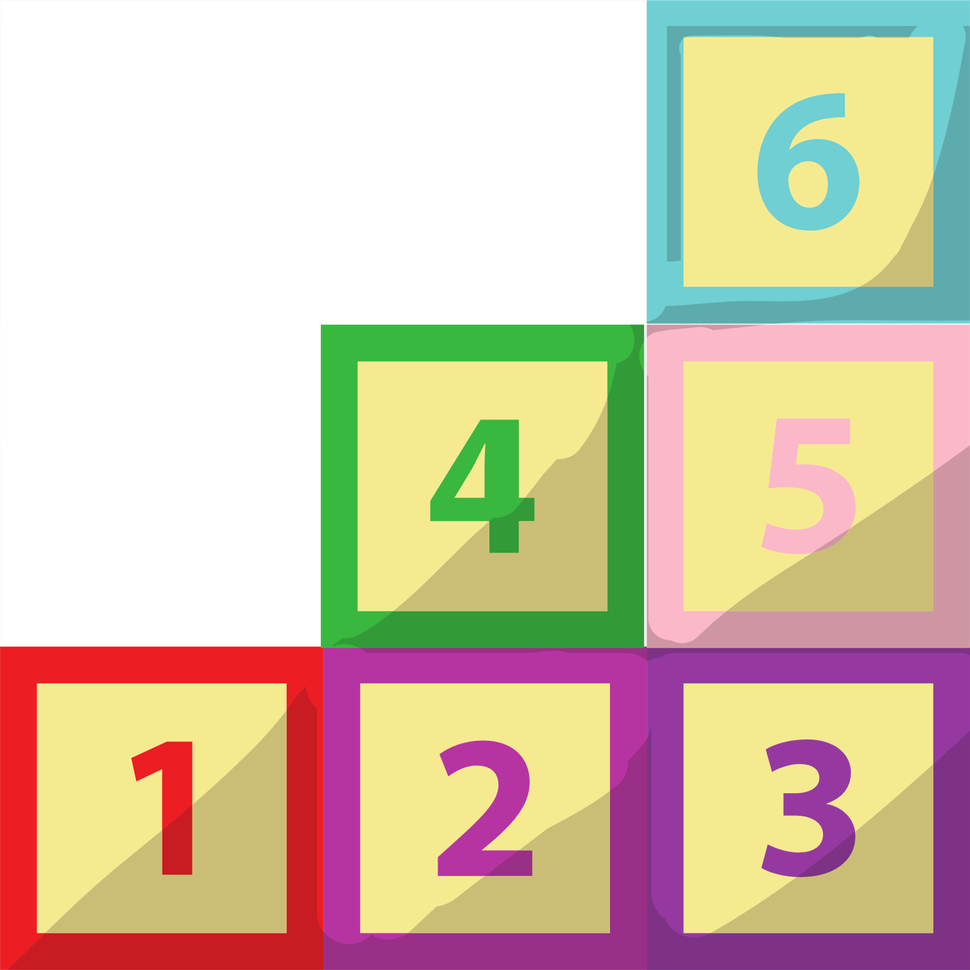
Dyscalculia
Dyscalculia is a learning disability that affects a child’s ability to understand, learn, and perform math and number-based operations (Jacobson, 2021)
Children with dyscalculia may experience:
Difficulty with numbers (doing math operations, counting)
Issues remembering numbers (zip codes, phone numbers)
Issues with money (counting money)
Difficulty with reading clocks/telling time
Low grades in math but excel in other subjects
(Jacobson, 2021)
Children with Dyscalculia need to have an accommodations (IEP/504) plan in school. So that in school, children can:
Receive extra time on assignments
Extra assistance as needed
Notes:
Dyscalculia is treatable.

Slide 18
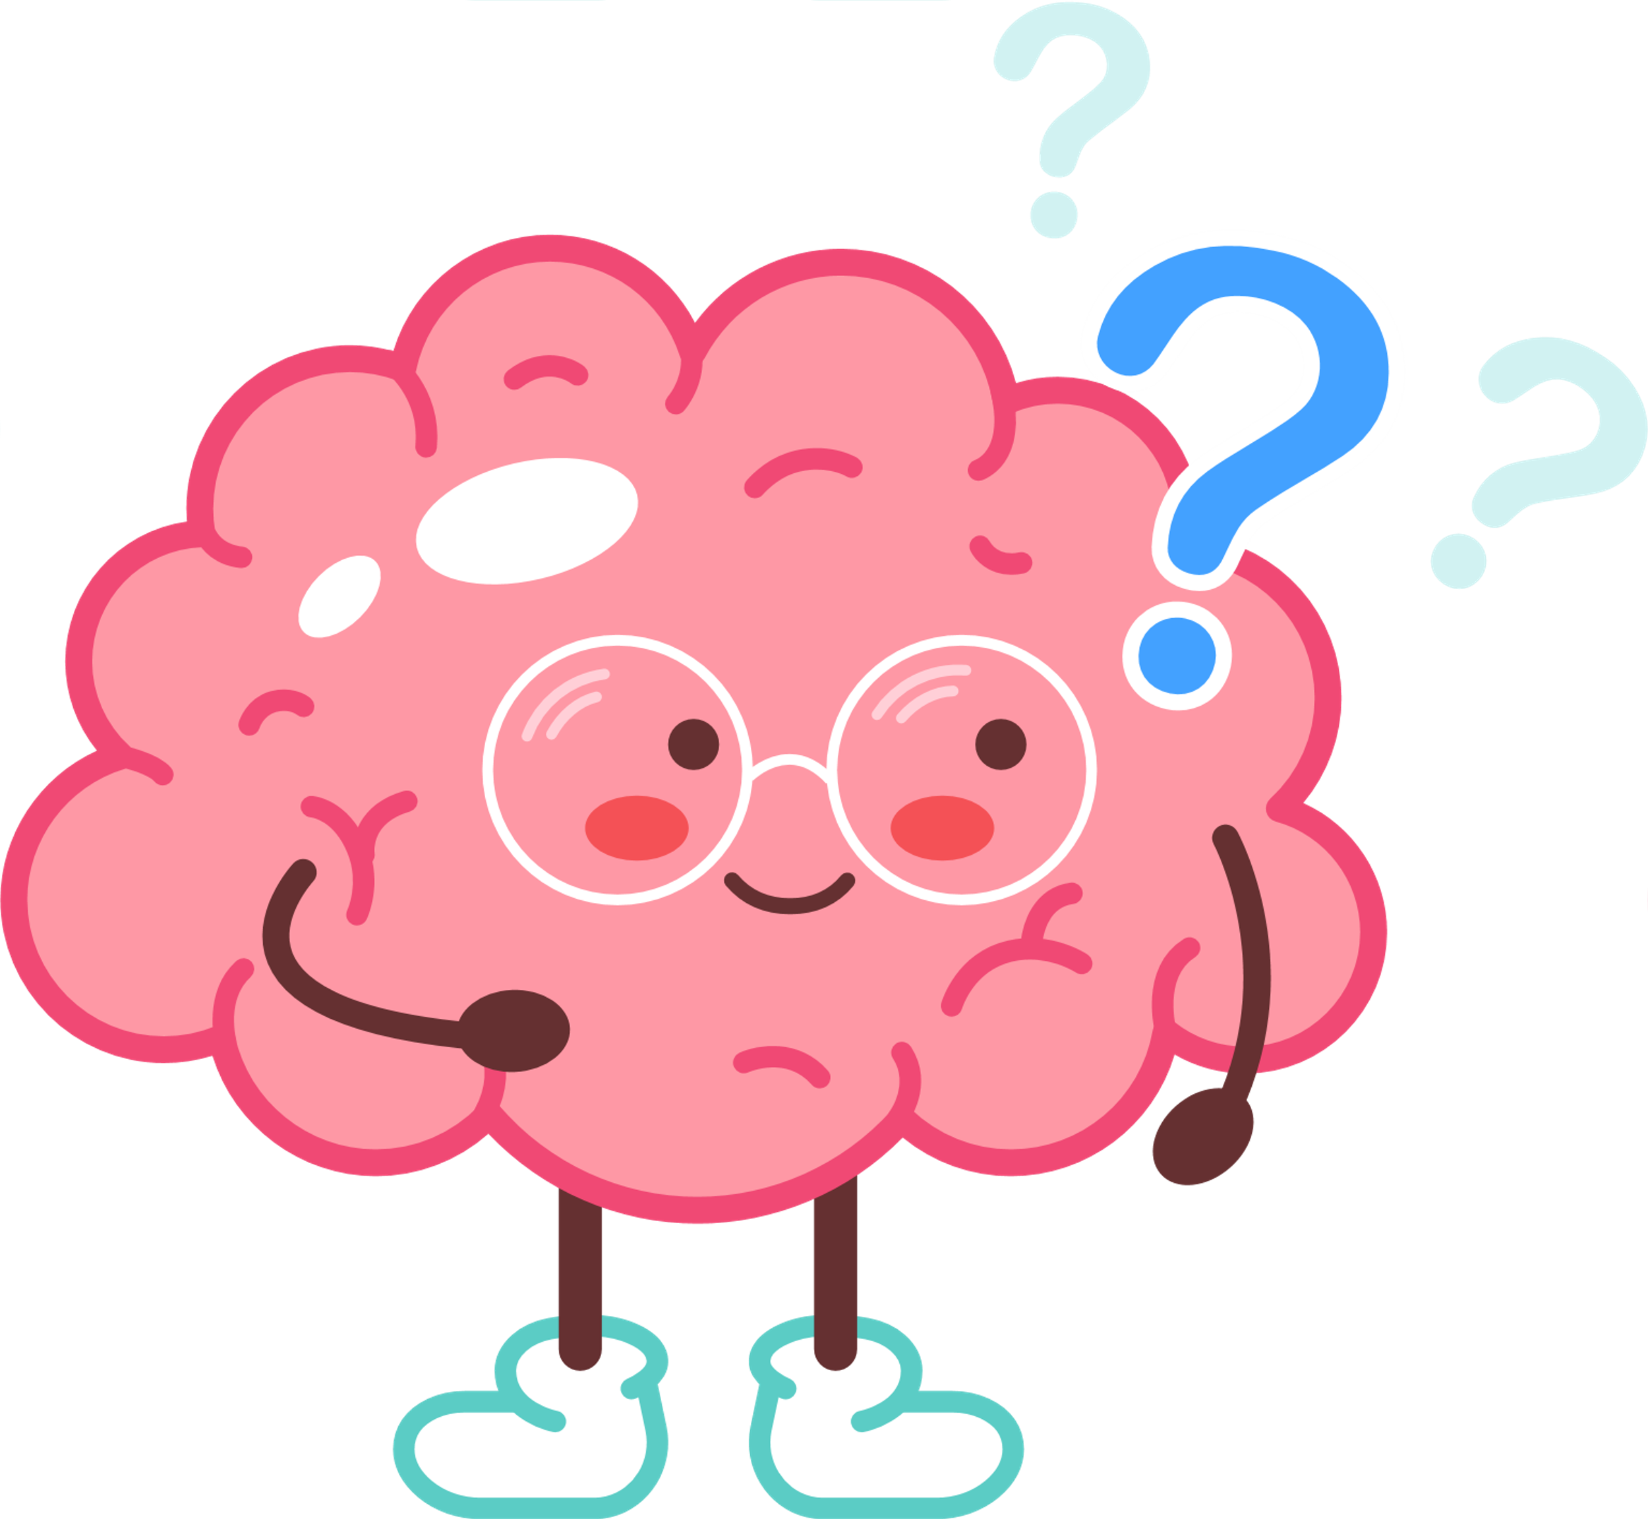
Tourette Syndrome
Tics typically appear around 2 to 5 years old.
Tourette Syndrome is a neurological disorder where children experience tics that are not easily controlled.
Males are more likely than females to develop Tourette Syndrome
(Mayo Clinic, 2018)

Slide 19
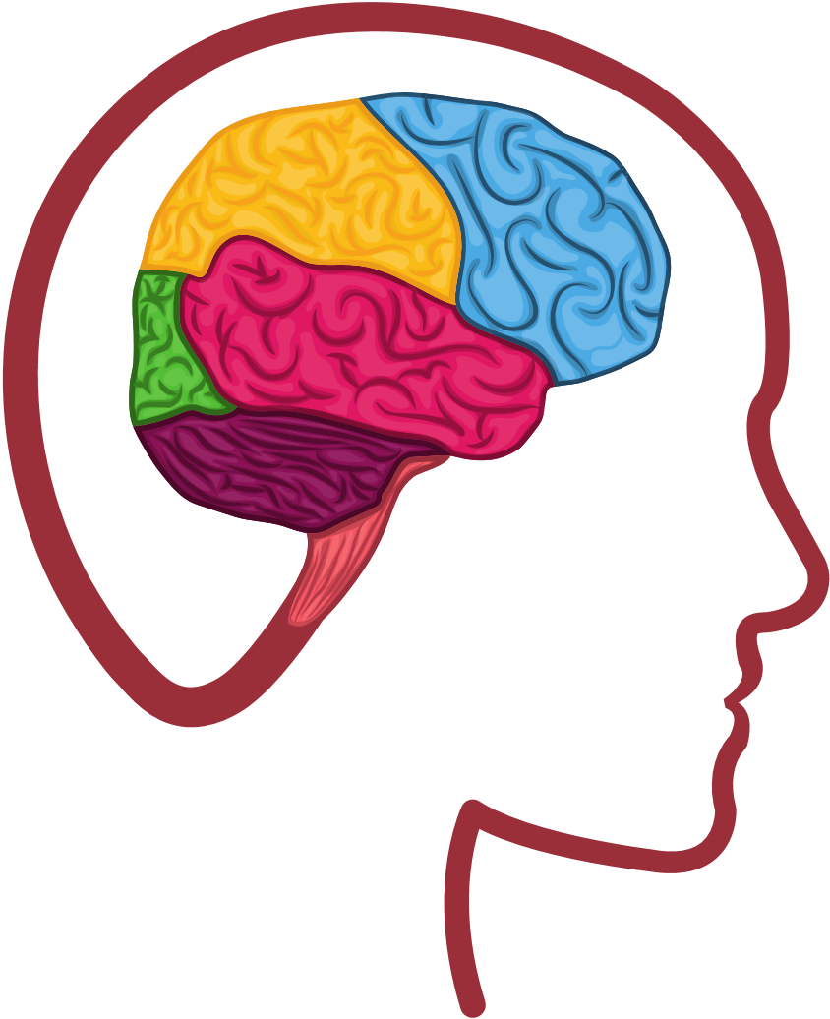
Benefits of Neurodiversity
As social service providers, we should work to empower our clients to understand their potential through a strength perspective approach.
Individuals with neurodiversity possess many abilities that allow them to have unique strengths.

Slide 20
Strengths of Individuals With Neurodiversity
Musical abilities
Strong visual-spatial skills
Strong abilities with systems, programming, and mathematics.
A heightened sense of creativity
Being able to approach situations in a unique way. Individuals have the ability to "think outside the box" and prescribed social norms.
Lack of societal pressure to prescribe to social norms
Increased ability to attention to detail

Slide 21
Characteristics of Neurodivergent Children
Explaining Neurodivergent Children (Levels of Severity)
Children's brains develop along an expected trajectory.
Neurodivergent children and teenagers have a unique pattern of behaviors and levels of severity.
Symptoms related to neurodivergent in children differ from child to child and many commonly go unnoticed.

Slide 22
The DSM classifies Autism Spectrum Disorder among three levels of severity:
LEVEL 1
LEVEL 2
LEVEL 3
When support is needed
Individual needs substantial support
Individual needs very substantial support
Individuals at this level may have symptoms that do not interfere much with relationships, school, or work.
Individuals at this level require some level of outside support in daily activities. Support can range from speech therapy or social skills training.
This level requires substantial outside support that is characterized by full-time assistance or intensive therapy.

Slide 23
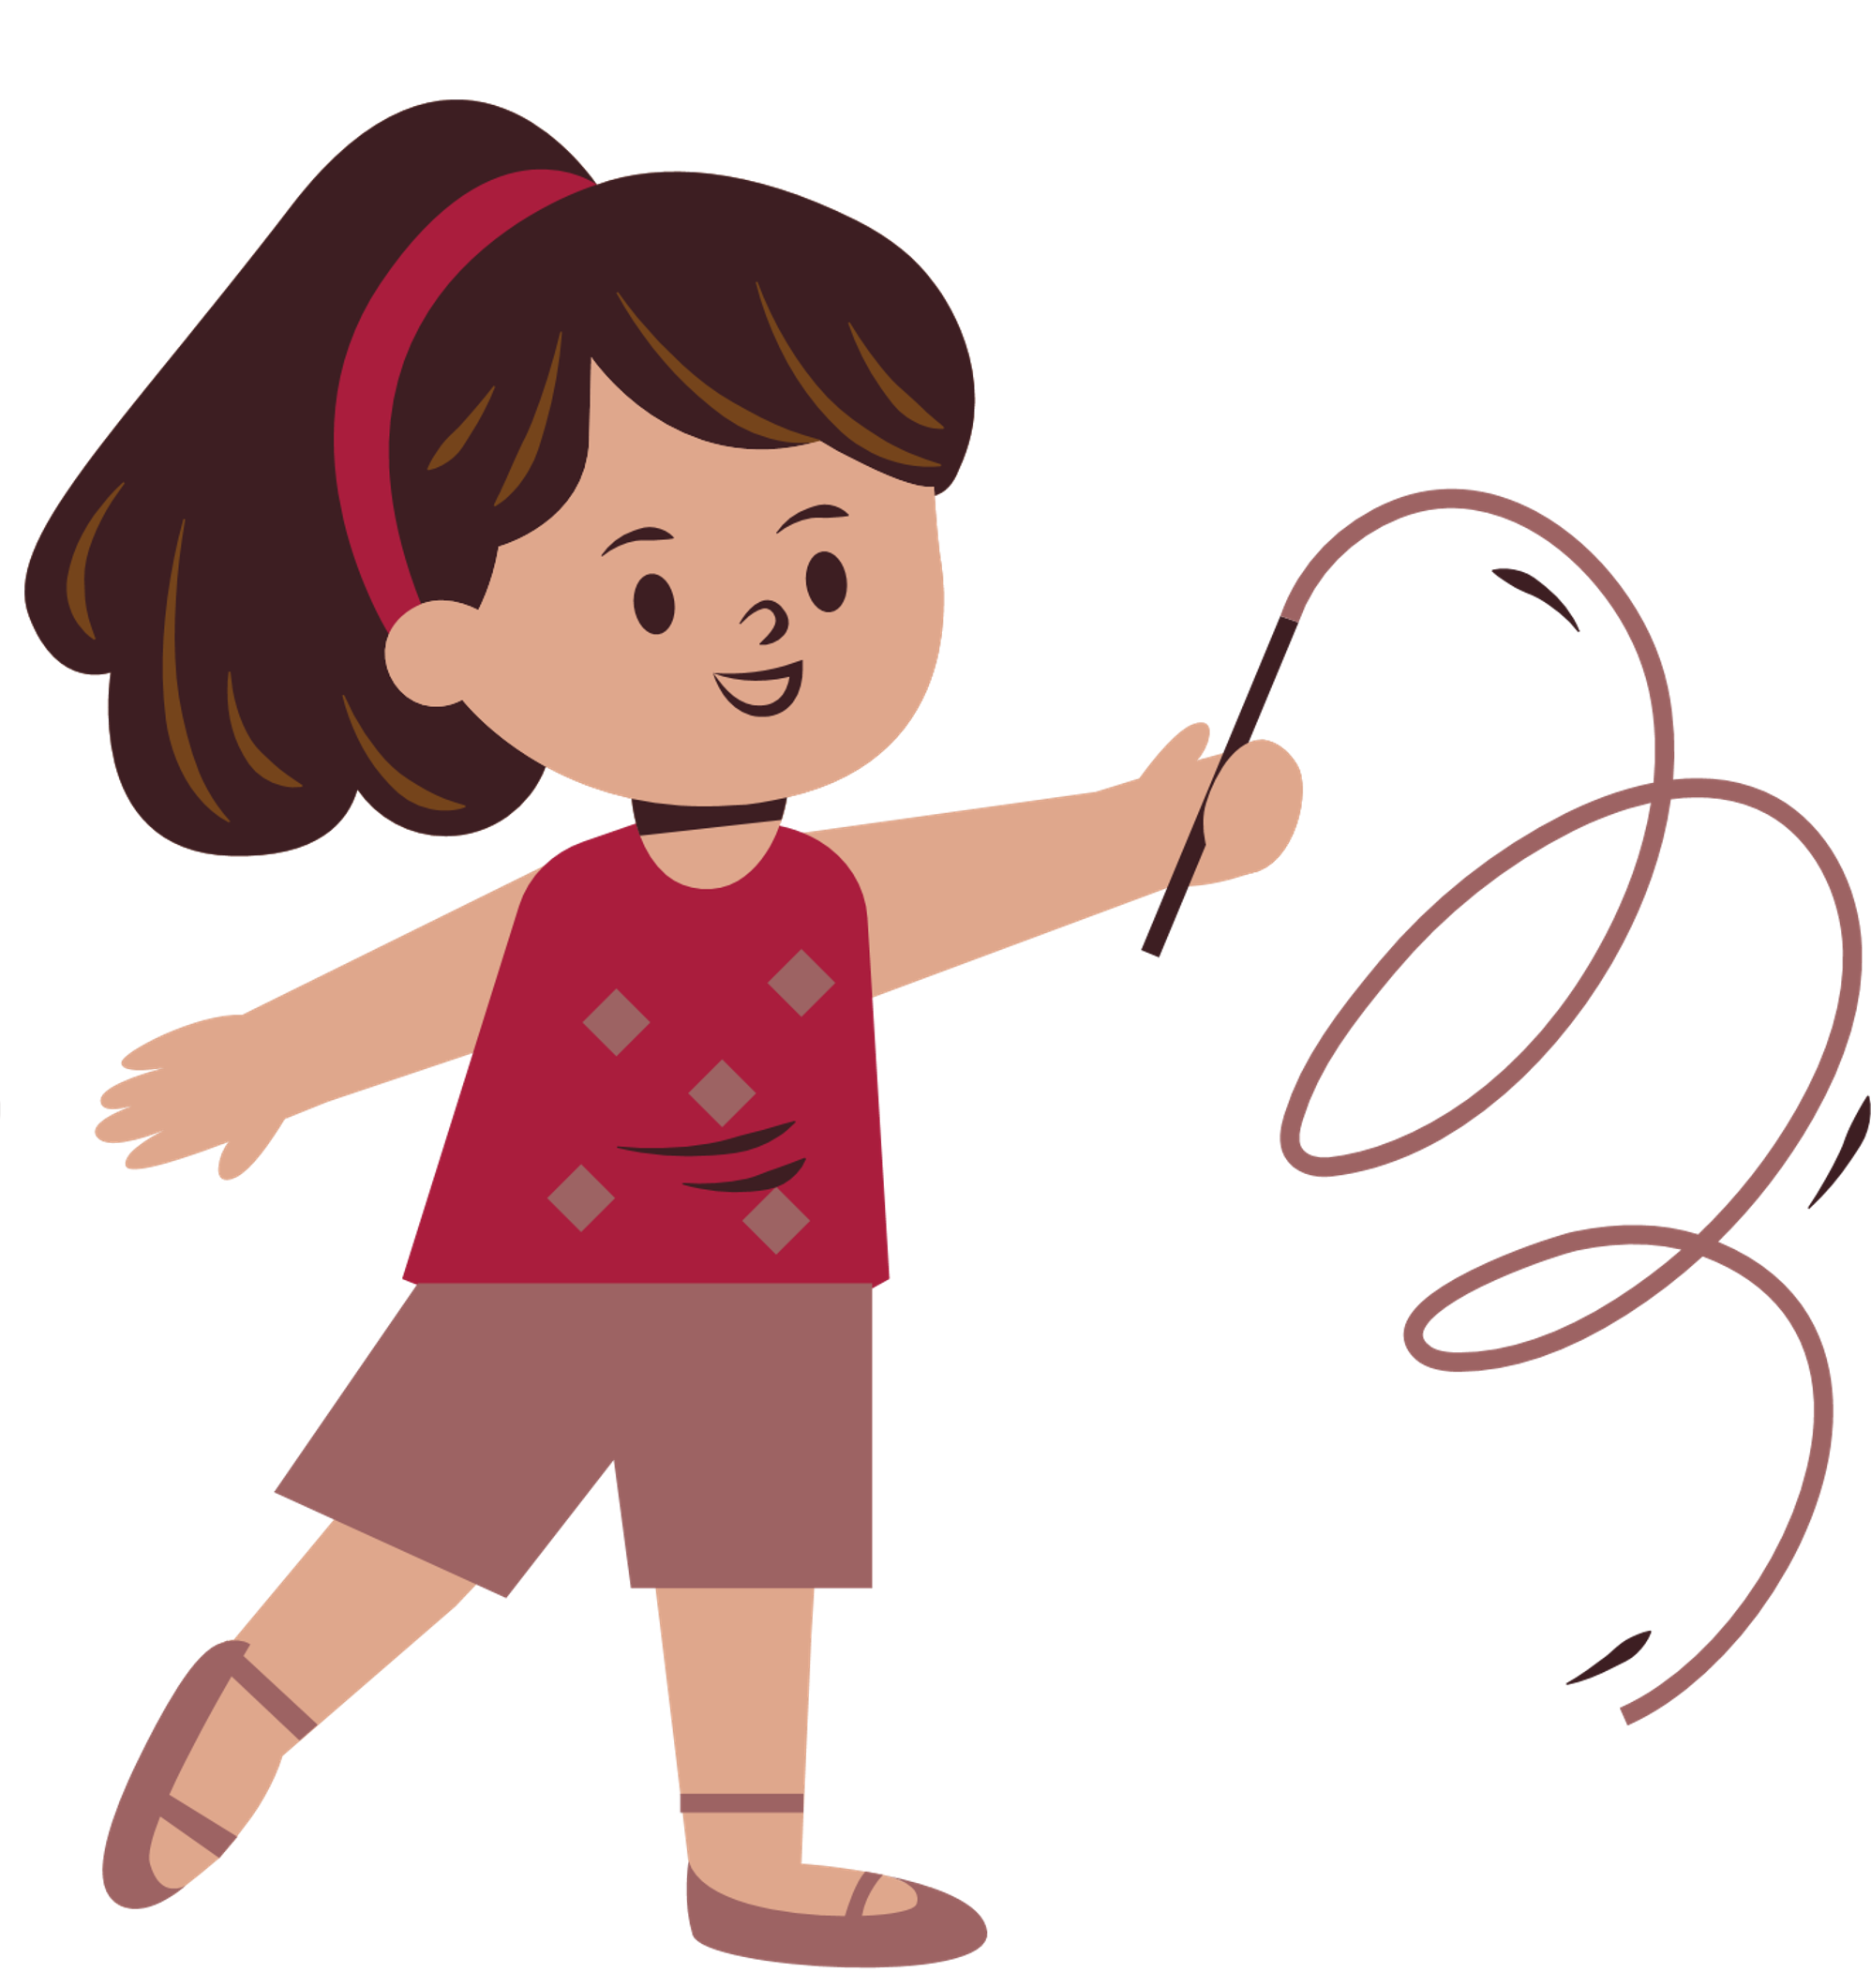
Symptoms of Neurodivergence in Children
No babbling or pointing by age 1
No single words by 16 months
No two-word phrases during or by age 2
No response to name
Regression or loss of language and social skills previously acquired
Poor eye contact
Lack of social responsiveness

Slide 24
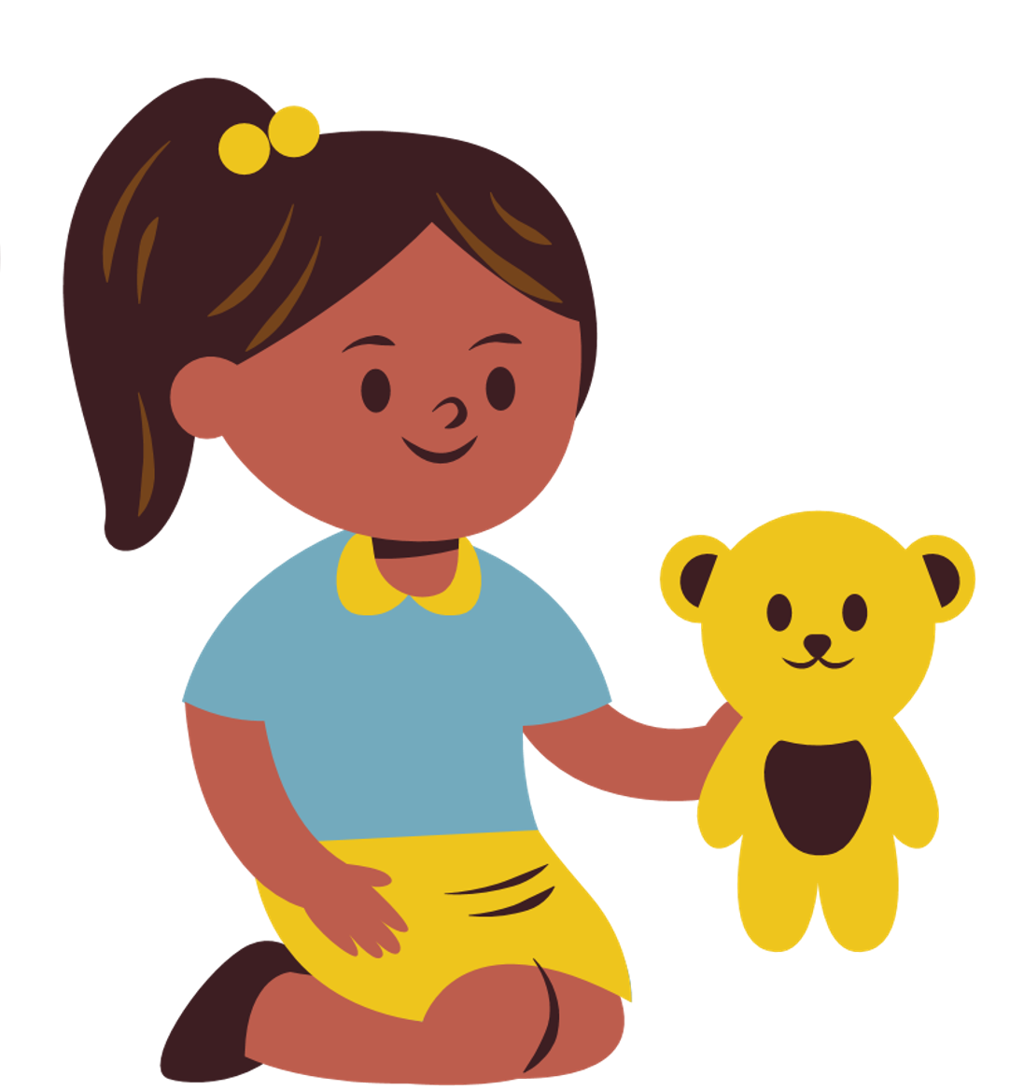
Later indications in children could be seen in indicators such as:
Limited ability to socially engage with peers or make friends
Repetitive or unusual use of language
Abnormally intense or focused interest
A sense of preoccupation with certain objects or subjects
Inflexible adherence to specified routines or rituals
(National Institute of Neurological Disorders and Stroke, 2013)

Slide 25
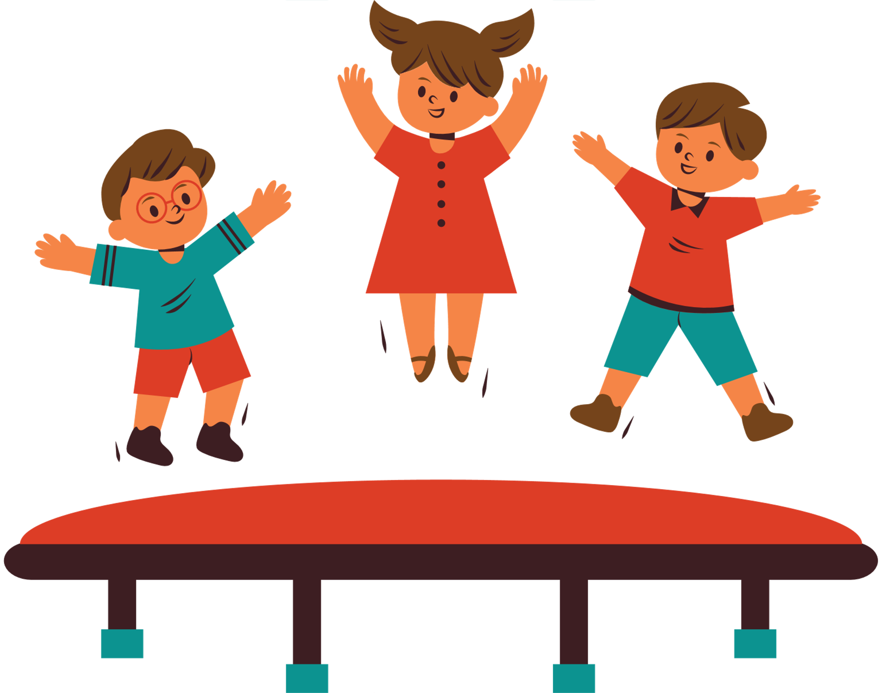
The Needs of Neurodiverse Children
Empowering young children to identify their brain functionalities and embrace their learning skills is essential to help neurodiverse children advocate for themselves.
Notes:
All children are unique and bring different personalities, characteristics, qualities, and more into our society; neurodiverse individuals have similar and additional qualities, characteristics, and sometimes needs.
Accommodation does not make anyone difficult or less than; knowing your weakness and asking for help is crucial for children to learn and understand.

Slide 26
AS CHILD WELFARE WORKERS,
WE MUST WORK TO ENSURE THAT NEURODIVERGENT CHILDREN GET THEIR NEEDS MET.
Below are some examples of how child welfare workers may empower children with disabilities:
Advocating accommodation
Viewing differences as uniqueness, not impediments
Identifying brain functionalities
Cultivating self-esteem
Positive thinking

Slide 27
Ways to Support a Neurodiverse Child at Home
Listen to what they have to say and avoid providing advice at that moment as it may cause overstimulation
Supporting neurodiverse children at home is essential as it lays the foundation for skills children can use to thrive.
Provide outlets for sensory activities to help with triggers and stress reduction
Establish a routine
Encourage them to recognize their strengths
Cap off a productive class with key summary points students can easily remember
Break large tasks into smaller ones; as it will aid with focus and prevent feelings of being overwhelmed
Encourage self-regulating activities like exercise
(Fava, 2021)

Slide 28
Easy and Effective Accommodations for Someone who is Neurodivergent
Awareness and willingness to be flexible
Changing and replacing things that may cause sensory challenges
Providing tech support for time management
Being sensitive to social differences
Focusing on various options for communicating information
Providing opportunities to learn and communicate in preferred ways

Slide 29
SUPPORTING CAREGIVERS OF NEURODIVERSE CHILDREN
Raising neurodiverse children can be a challenge for parents. Caregivers of neurodiverse children may face challenges such as:
Ensuring that the child receives their accommodations as needed
Adjusting their parenting skills to meet the needs of their child
Getting the proper diagnosis for their child
Facing the stigma surrounding neurodiversity

Slide 30
SUPPORTING CAREGIVERS
Caregivers should be encouraged to seek assistance or services
Examples of activities that caregivers can do to manage and cope include:
Learning about resources available to assist the child and their families
Joining a support group for parents of neurodiverse children
Read books written by and for parents with neurodiverse children
Individual therapy
(Brown et al., 2020)
Notes:
Caregivers of neurodiverse children need to know that they are not alone and are not expected to know all the answers.
Caregivers should be encouraged to seek assistance or services to improve their parenting skills, cope, and manage their stress appropriately.

Slide 31
Supporting children during social situations
Understanding the various triggers that your child experiences in social situations is important to provide outlets and resources to comfortably integrate themselves into society.
Talk through possible social scenarios and use visual aids if necessary.
Reinforce positive behaviors and celebrate strengths.
Provide them with sensory items they can use throughout the day. (ex. fidget spinner or stress ball)
Model and practice desired behaviors
Find tools to minimize triggers in social situations.
If your child suffers from anxiety, consider making speech cards to help them speak to other people.

Slide 32
The Conventional Medical Paradigm
The conventional medical paradigm, also referred to as the medical model of disability which approaches autism as a disability that is primarily rooted within individuals.
(Pellicano & Houting, 2021)

Slide 33
The medical paradigm focuses on the notion that disability is correlated and a direct consequence of a person's biological functioning and make-up.
As social service providers, it is important to understand how neurodivergence is understood across multidisciplinary settings to equip clients with skills to understand that their perceived “deficits” do not define them and can be used as strengths to navigate the world.

Slide 34
The Medical Model of Disability
IMPAIRMENT AND CHRONIC ILLNESS OFTEN POSE REAL DIFFICULTIES BUT THEY ARE NOT THE MAIN PROBLEM
the individual
the
problem
TRADITIONAL VIEW
problem
problem
focus of the medical profession
disability is caused by
"cure"
alleviate the effect
problem
problem
physical
sensory
mental
the individual
impairment
problem
impairment
problem
is
impaired
is
the problem

Slide 35
Social Model of Disability
The social model of disability is a model to help view the world. The model describes how individuals are disabled by barriers in society and not their impairment or difference.
Barriers include physical barriers like lack of accessibility in buildings or individuals' biases and attitudes toward neurodivergent individuals.
This model helps us recognize barriers in society toward neurodivergent individuals and the need to remove these barriers to create a more equitable society.

Slide 36
THE SOCIAL MODEL OF DISABILITY
Poorly designed buildings
Poor job
prospects
Stairs not ramps
No lifts
Isolated families
Special Schools
Inaccessible transport
No parking places
Few sign language interpreters
Discriminations
The Social Model of Disability states that the oppression and exclusion people with impairments face is caused by the way society is run and organized.

Slide 37
Neurodiversity across Cultures
Among varying cultures number of diagnoses differs based on the medical and cultural implications of how neurodivergence is viewed.
When working with children and families it is important to note that there are different views about how neurodiversity is understood and defined.
Some cultures have yet to accept the paradigm of neurodiversity and associate cognitive diversity with a mental health disorder which leads to high stigmatization underdiagnosis and misdiagnosis.

Slide 38
WHAT IS A NEURODIVERSE FAMILY?
The presence of one or more children on the spectrum within a family impacts both parents and siblings.

Slide 39
Impacts on Parents & Caregivers
Parents of neurodivergent children experience greater parenting stress compared to parents of neurotypical developing children
(Bishop-Fitzpatrick et al., 2018).
Research has found that parents of children on the autism spectrum report
increased gratitude
increased appreciation & respect
increased understanding of themselves
(King et al., 2006)
Children’s challenging behaviors and parent stress can impact the child-parent relationship.
Notes:
Children’s challenging behaviors and parent stress can impact the child-parent relationship. This could mean that heightened parental distress may lead to additional challenging behaviors.
Some qualitative studies find that parents of children on the autism spectrum report increased gratitude for what is important in life, increased appreciation of the importance of respecting and accepting others, and an increased understanding of themselves (King et al., 2006)

Slide 40
Working with Neurodiverse children and their families
Individuals with neurodevelopmental disabilities may have delays or challenges with communication, language, understanding and responding to emotion, and regulating behaviors which may cause acute stress to changes, grief, loss, and crisis.
Notes:
When first meeting with families, it is crucial that child welfare workers ask if any children in the household have a disability such as the conditions previously mentioned.
If so, the child welfare worker should follow up and gather as much background information as possible such as diagnosis, current treatment, and prescription status.
Workers might consider referring to a child for an evaluation if presented with the following situations:
The caregivers express that the child has difficulties with coordination, movement, reading, math, socializing, communicating, attention, or behavioral issues.
The child discloses having difficulties with coordination, movement, reading, math, socializing, communicating, attention, or behavioral issues.
The child welfare professional observes any concerning delays or behaviors from the child.
Once a referral has been made, ensure to follow up with the agency to see if the child has been diagnosed. Neurodiverse children must receive a diagnosis so that they can begin treatment. Without a diagnosis, neurodiverse children may not have access to various accommodations that are typically available. With suitable accommodations, neurodiverse children can thrive.

Slide 41
The following are tips and resources for social service providers and supervised visitation staff to support efforts in addressing stress responses and crises with neurodiverse families.

Slide 42
Be aware of how stress presents itself
Common stress responses include emotional, physical changes, or regression of behaviors.
Emotional Changes
Physical changes
- Sadness
- Irritability
- Crying
- Silence
-Aggression
- Social isolation
-Impulsivity
-Headaches
-Stomach aches
- Changes in appetite or sleep

Slide 43
Help the individual process the situation
- Be open and talk about the situation in an honest and developmentally appropriate manner.
- Use visual supports to identify emotions if the individual is nonverbal.
- Validate and normalize feelings.
- Remind individuals that they are safe and have support in their environment
- Allow space for individuals to process the event in their own way

Slide 44
Maintain a consistent routine and establish a sense of normalcy after a crisis or sudden change
Model calm behavior and engage the neurodivergent individual in coping exercises
Know when to seek additional resources for the family

Slide 45
Ensure that research, diagnosis, and any proposed intervention
are always rigorous, empirical, family-centered, culturally grounded, and methodologically sound (Freeth et al., n.d.).
Recommendations for Social Service Providers
Establish a culture that treasures the strengths of neurodiverse individuals
Empower neurodiverse individuals to build their identity and enhance their long-term skills
Equip caregivers with tools to aid in reducing parental stress and increasing parent resilience
Emphasize curiosity and holism to our clients.
Notes:
Establish a culture that treasures the strengths of neurodiverse individuals
Empower neurodiverse individuals to build their identity and enhance their long-term skills of daily living throughout the lifespan this means looking at the strengths of difference.
Equip caregivers with skills and encouragement.
It is important to validate caregivers' feelings and equip them with skills to have self-compassion.
Social service providers should focus on equipping parents with tools to aid in reducing parental stress and increasing parent resiliency.
Emphasize curiosity and holism to our clients.

Slide 47
THANK YOU!
Questions?
lbradley2@fsu.edu

