Slide 1
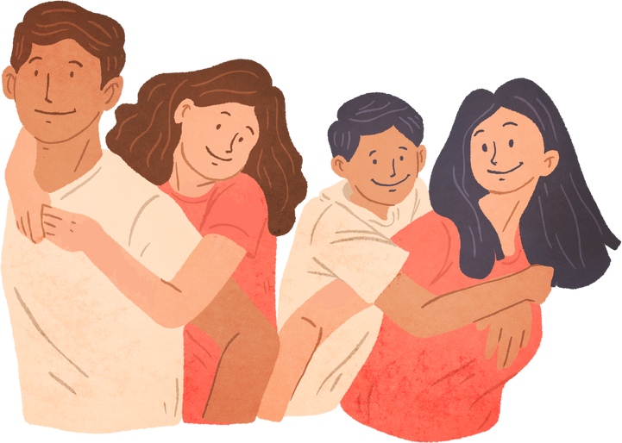
Parental Motivation to Change
Florida State University

Slide 2
Overview
Motivational Interviewing Defined
Four Processes of MI
MI Tips
Scenario

Slide 3
Motivational Interviewing
A collaborative, goal-oriented style of communication focused on the language of change.
Designed to strengthen personal motivation and commitment to a specific goal by eliciting and exploring an individual's own reasons for change within an atmosphere of acceptance and compassion.

Slide 4
Motivation
Important for behavior change
Multidimensional
Interactive
Dynamic
Able to be influcenced
Changeable

Slide 5
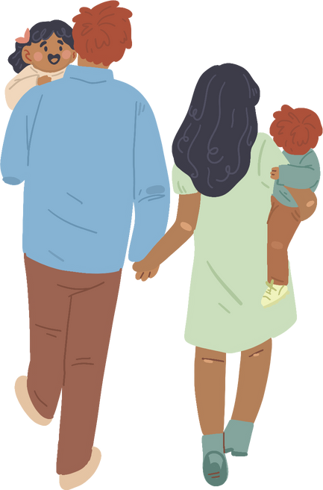
Motivational Interviewing is not
A pro and con conversation
About providing assessment feedback
A way to trick people into doing what you want
A linear stage process

Slide 6
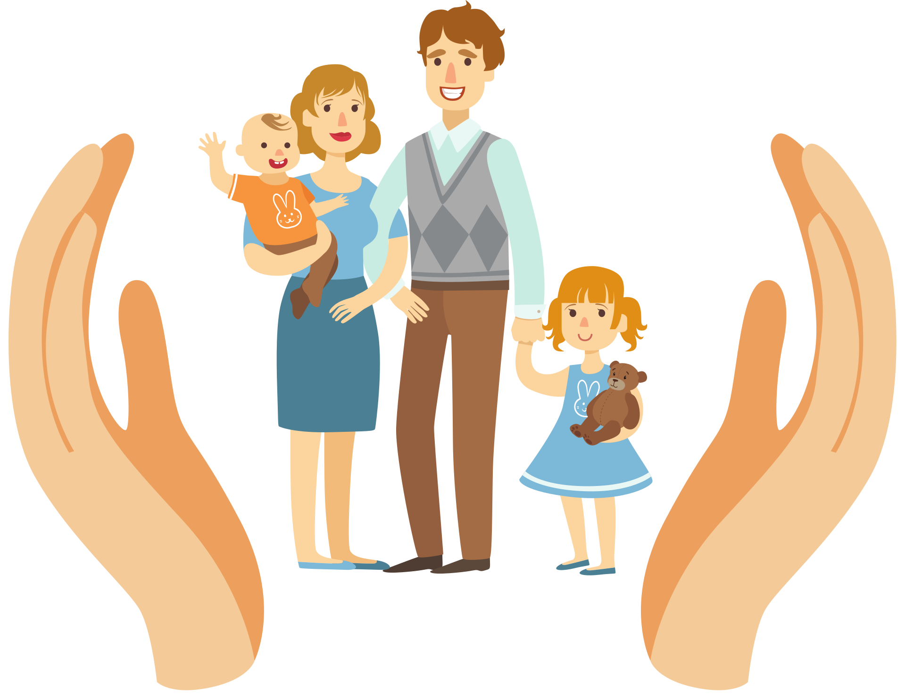
How to Encourage Motivation
Set the tone and create an environment welcoming of change
Reinforce that you are committed to creating a supportive space
Demonstrate empathy and compassion
Be open and look for strengths

Slide 7
Four Processes of MI
Engage
Finding ways to connect
Focus
Identifying a clear change in focus
Evoke
Exploring the individual's own reasons for change
Plan
Collaborating with individual to reach goal

Slide 8
Engaging Process
Engagement is fundamental for effective communication. It helps establish a working relationship with families and other individuals.
Belief
Trust
Listening
Affirmation
Establishing a mutually trusting and helping relationship
Listening to understand & asking open-ended questions
Affirming strengths, successes, and personal characteristics
Believing that one can improve

Slide 9
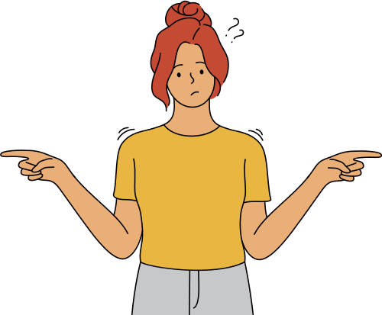
Ambivalence
A common part of contemplating change
Ambivalence is when one feels two ways about a situation and the individual can see the pros and cons of changing and not changing.
It is not reluctance toward change
It is not lack of caring

Slide 10
Fixing Reflex
Our natural tendency is to want to help and problem solve. But we can't. It usually results in push-back.
Avoid saying:
"Why don't you try...?"
"I think you should..."
"What I would do is..."
"You need to..."

Slide 11
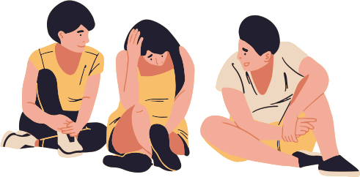
Tip #1: Yield
Stop and identify whether the resistance in the relationship is discord or sustain talk.
Discord Talk
Sustain Talk
Statements about the intervention process or relationship with the individual.
Statements where the client expresses the way things are, their feelings about change, and reasons for keeping things the same.
Examples:
I just don't like you
I don't trust you
Examples:
I just don't want to
I don't know how
Notes:
Examples of Discord Talk:
- I just don't like you
- I don't trust you
Examples of Sustain Talk:
- I just don't want to
- I don't know how to

Slide 12
Tip #2: Active Listening
Active listening involves making a conscious effort to hear, understand, and retain information that is being relayed.
To achieve effective engagement, one must actively listen to everything a client is communicating and pay attention to their body language.
Examples of Active Listening Skills:
Maintaining eye contact
Good body language (sitting up straight, nodding, and relaxed arms)
Putting away any electronics or devices that may be distracting
Paying attention to the other individual's body language as they communicate.

Slide 13
Change Talk
Conversations where an individual is expressing their desire towards change
Preparatory Change Talk
Mobilizing Change Talk
Statements that express motivation for change without expressing commitment to make a change
Statements that express/imply actions towards a change

Slide 14
DARN-CAT
Preparatory Change Talk= DARN
Mobilizing Change Talk= CAT
Statements that express motivation for change without expressing commitment to make a change
Statements that express/imply actions towards a change
Desire
Ability
Reason
Need
Activation
Commitment
Taking Steps
I want to change.
I have a good reason to change.
I need to change.
I will make changes.
I am getting prepared to make the changes.
I have started to make changes.
I can change.

Slide 15
Sustain Talk
Expressions that support the status quo and unwillingness to change
Examples of Sustain Talk:
I don't want to.
I don't know how.
I have no reason to change.
Everything is fine

Slide 16
Focusing Process
A collaborative process where the client and the staff member find a mutually agreeable direction for change.
What's one thing you wish was different?
Client and staff members work on identifying specific goals and targets together.
I wish I could find low cost counseling.
Note
Premature focus without sufficient engagement can slow down the change process.

Slide 17
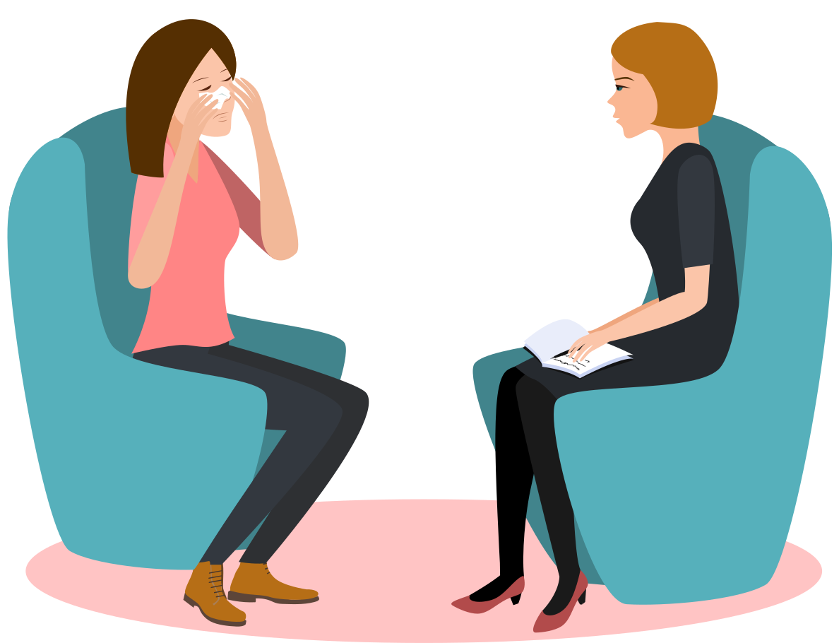
Evoking Process
Involves exploring an individual's ambivalence and reasons for change
Depending on the amount of change and sustain talk an individual uses, one can predict their readiness towards change
In this process, one should focus on change talk and begin planning
How do you feel about quitting substances?
I don't think I can do this but I want my kid back.

Slide 18
Tip #3: Open-Ended Questions
What will things be like if you do not change?
Tell me more about that
Give me an example
What does that look like?
What makes you think you need to change?
What would you like to see different about your current situation?
What will you need to do to make that happen?
What else?

Slide 19
Tip #4: Affirmations
Positive statements that emphasize an individual's personal strengths, resources, and successes
Benefits
Assists in developing self-efficacy
Builds confidence that change is possible
Prevents discouragement
Communicates the individual is valuable

Slide 20
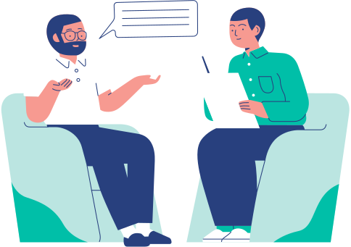
Tip #5: Reflect
Echo
Validate
Paraphrase
Deepen
Allow the speaker to hear their own message back to them
Validate the individual and encourage them to share more about their life and the need to change
Paraphrase what you understand the individual is saying
Reflect back on the individual's words using unstated thoughts and feelings
Ex: " I understand you are frustrated about not having the freedom to see your child as often as you'd like to. But let's sit down and see how we can make supervised visitation work to build a better relationship with your son"
Ex: "I hear that you would like to see your child more often."
Ex: " I can tell you really struggled with visitation. Ideally, how would you like your relationship with your child to look? "
Ex: " From what I am hearing, you feel like supervised visitation is preventing you from strengthening your bond with your child"

Slide 21
Tip #6: Summarize
Recap different points that the client made and present it to them
Captures the heart of evoking
Highlights what is the most important in the conversation
Helpful in maintaining a focused conversation

Slide 22
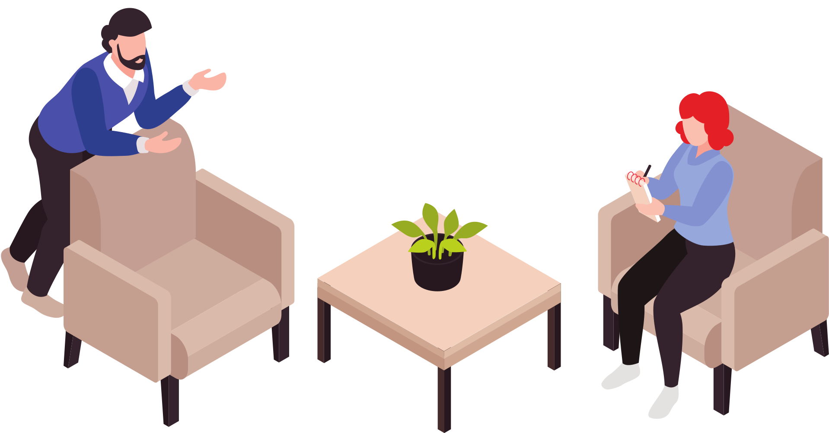
Tip #7: Ask-Tell-Ask
People are the experts of their own lives
Ask
Ask
Get input about their goals and plans first
Ask for feedback on the information provided to them
Tell
After probing, offer helpful ideas or suggestions that may help them achieve their goals and plans

Slide 23
Example of Ask-Tell-Ask
Ask
What are some things you'd like to work on?
Client: I want to build a healthy relationship with my children.
Ask
Is that something that you'd be interested in trying?
Tell
In the past, I've seen parents build a healthy relationship with their children by attending all their supervised visitations with their children and doing some activities that the kids enjoy during visitation.

Slide 24
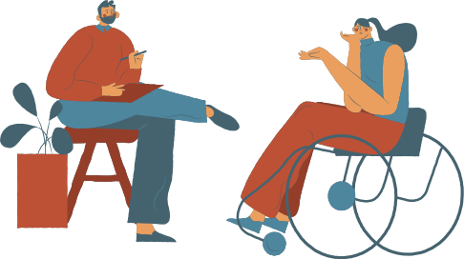
Planning Process
Involves judging and reading the individual's signs of readiness
Focus on the individual's values
Provide a variety of options to empower individual choice
Use previous strategies that have worked before
Offer information to help the individual to make an informed choice

Slide 25
Case Scenario
Steve has attended supervised visitation three times. At his last visitation, he got angry at a staff member for supervising his visitation with his son and started yelling. He stated that if it were not for his son’s mother and her new boyfriend snitching about his cocaine usage that he would be able to be at home with his son. He further claims that he does not have any issues with substances and that his substance usage does not get in the way of him being a good father. The staff member asked him to stop yelling but he refused. Due to his behavior, Steve was asked to leave early from his scheduled visitation and was informed that he could return next week.
What are some things that a staff member can do in this scenario?

Slide 26
Case Scenario
Steve has attended supervised visitation three times. At his last visitation, he got angry at a staff member for supervising his visitation with his son and started yelling. He stated that if it were not for his son’s mother and her new boyfriend snitching about his cocaine usage that he would be able to be at home with his son. He further claims that he does not have any issues with substances and that his substance usage does not get in the way of him being a good father. The staff member asked him to stop yelling but he refused. Due to his behavior, Steve was asked to leave early from his scheduled visitation and was informed that he could return next week .
What are some things that a staff member can do in this scenario?
Engage with Steve and listen to why he believes that he does not have substance issue and is a good dad.
Help him focus on identifying and creating goals/plan that he wants to accomplish
Explore with Steve his ambivalence towards substances.

Slide 27
Thank You

Slide 28
References
Luther, J., & Brumm, S. (n.d.). Parent Engagement and Motivation to Change: Tips for Practice.
Motivational Interviewing: Helping People Change
Portico. (n.d.). MI: Sustain talk and discord​. Retrieved from https://www.porticonetwork.ca/treatments/treatment-methods/motivational-interviewing/mi-sustain-talk-and-discord
This presentation was adapted from a seminar of the Center for the Study and Promotion of Communities, Families, & Children

