Slide 1
RESOURCES TO HELP YOU THROUGH COVID-19
Find the help that is right for you

Slide 2
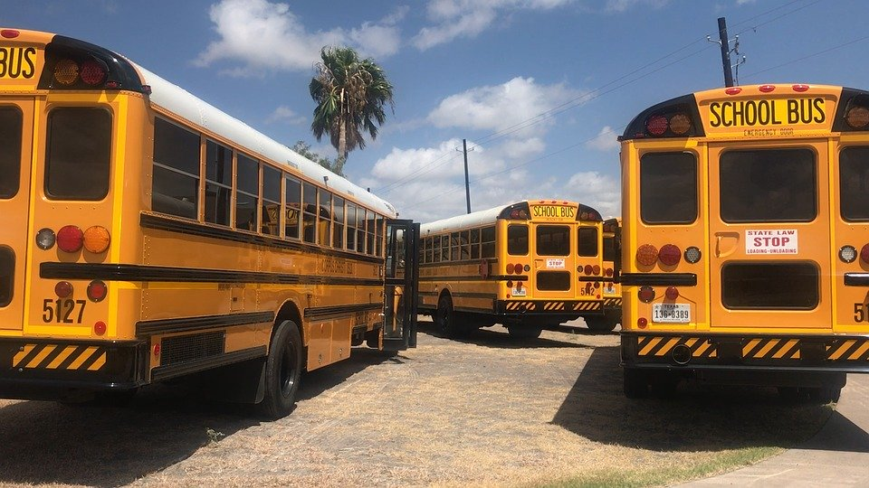
SCHOOLS AND CHILDCARE
Keep track of the school dismissal updates
Talk to your school about options for digital and distance learning
Discourage children from gathering in public places to help slow the spread of COVID-19
Practice and reinforce good prevention habits with your family
Interim Guidance on Management of Coronavirus Disease 2019 from Centers for Disease Control and Prevention (CDC).
https://www.cdc.gov/coronavirus/2019-ncov/community/schools-childcare/index.html

Slide 3
COLLEGES AND UNIVERSITIES
Explore student support services such as online library services, print materials available online, phone- or internet-based counseling support, or study groups enabled through digital media.
Keep track of the university dismissal updates
Review new assignments, learning, and research.
Communicate with your professor/peers about any issues you are facing
Interim Guidance on Management of Coronavirus Disease 2019 from Centers for Disease Control and Prevention (CDC).
https://www.cdc.gov/coronavirus/2019-ncov/community/colleges-universities/faq.html

Slide 4
HOME RESOURCES
Know the signs and symptoms of COVID-19 and what to do if you become symptomatic.
Practice personal protective measures (e.g. hand washing).
Create a household plan of action*
Ensure 30-day supply of all medicines.
Avoid gatherings or other situations of potential exposures, including church attendance and social events with 10 or more people as much as possible.
Avoid cruise travel and non-essential air travel
*What you can do to prepare, if you or a family member gets ill, or if your community experiences spread of COVID-19
https://www.cdc.gov/coronavirus/2019-ncov/downloads/community-mitigation-strategy.pdf
Interim Guidance on Management of Coronavirus Disease 2019 from Centers for Disease Control and Prevention (CDC).https://www.cdc.gov/coronavirus/2019-ncov/cases-updates/florida.html

Slide 5
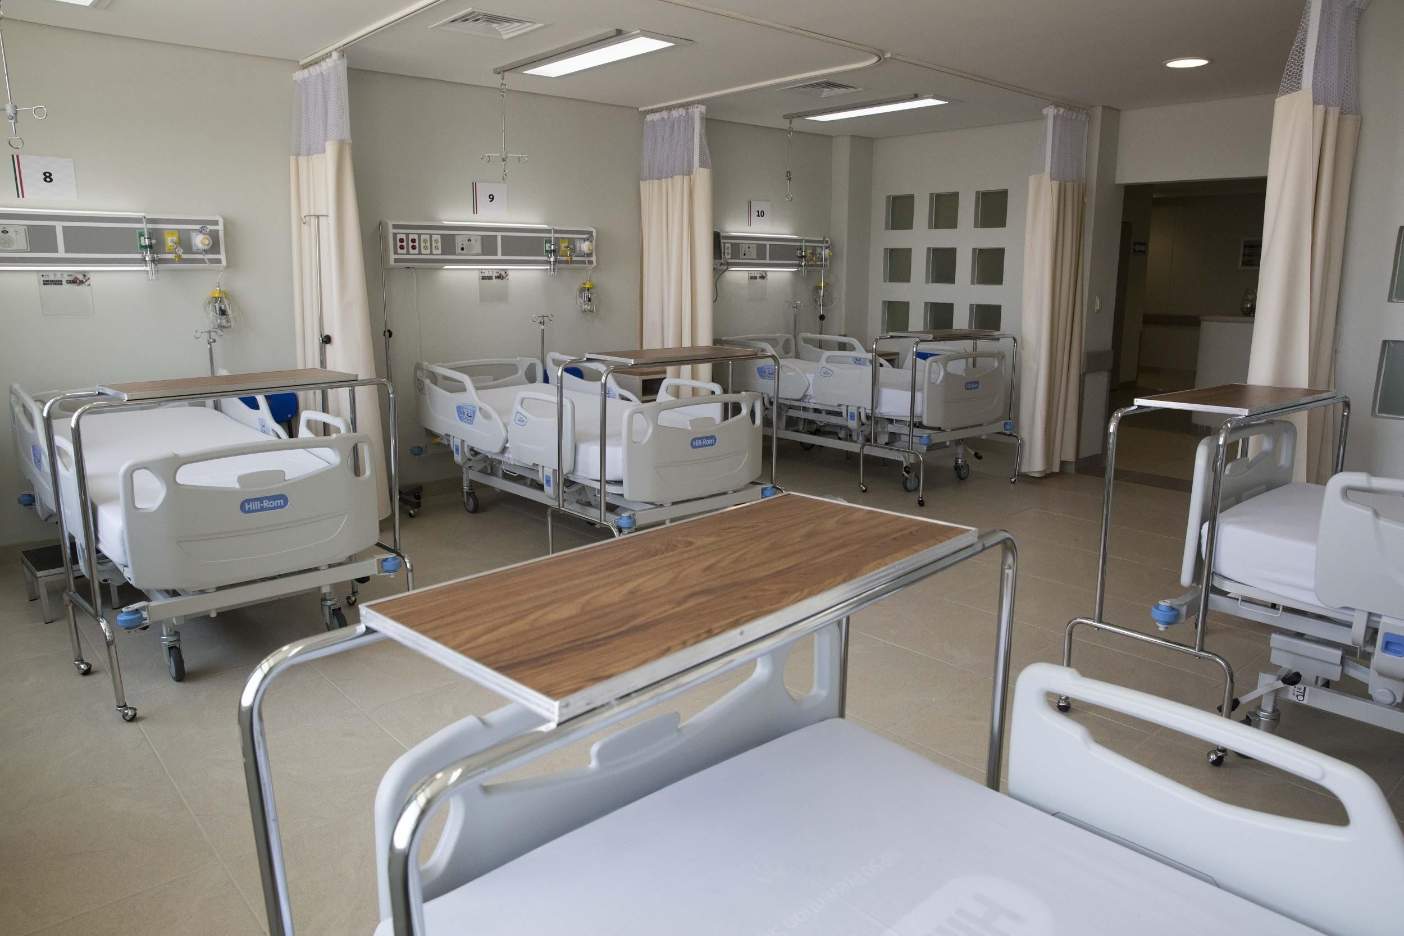
CARE AND TREATMENT OF MENTAL AND SUBSTANCE USE DISORDERS
Inpatient facilities should be reserved for those for whom outpatient measures are not considered an adequate clinical option
Use of telehealth and/or telephonic services to provide evaluation and treatment of patients
Consideration of the use of buprenorphine products to treat opioid use disorder
Considerations for the Care and Treatment of Mental and Substance Use Disorders in the COVID-19 Epidemic: March 20, 2020
https://www.samhsa.gov/sites/default/files/considerations-care-treatment-mental-substance-use-disorders-covid19.pdf

Slide 6
UNSHELTERED / HOMELESS
Establish ongoing communication with your local public health department to facilitate access to relevant information before and during an outbreak.
In general sleeping areas (for those who are not experiencing respiratory symptoms), ensure that beds/mats are at least 3 feet apart
Identify a list of key contacts
Identify a list of healthcare facilities
Include contingency plans
Interim Guidance for Responding to Coronavirus Disease 2019 (COVID-19) among People Experiencing Unsheltered Homelessness
https://www.cdc.gov/coronavirus/2019-ncov/community/homeless-shelters/unsheltered-homelessness.html

Slide 7
CORRECTIONAL AND DETENTION FACILITIES
Verbal screening and temperature check protocols for incoming incarcerated/detained individuals, staff, and visitors
Reinforcing hygiene practices, intensifying cleaning and disinfection of the facility, screening (new intakes, visitors, and staff), continued communication with incarcerated/detained persons and staff, and social distancing measures
Read signage posted around the correctional facility
Report symptoms to staff
Interim Guidance on Management of Coronavirus Disease 2019 (COVID-19) in Correctional and Detention Facilities https://www.cdc.gov/coronavirus/2019-ncov/community/correction-detention/guidance-correctional-detention.html

Slide 8
DEALING WITH ANXIETY
Take breaks from watching, reading, or listening to news stories, including social media. Hearing about the pandemic repeatedly can be upsetting.
Take care of your body. Take deep breaths, stretch, or meditate
Try to eat healthy, well-balanced meals, exercise regularly, get plenty of sleep, and avoid alcohol and drugs
Make time to unwind. Try to do some other activities you enjoy.
Connect with others. Talk with people you trust about your concerns and how you are feeling.
Things you can do to support yourself
https://www.cdc.gov/coronavirus/2019-ncov/prepare/managing-stress-anxiety.html

Slide 9
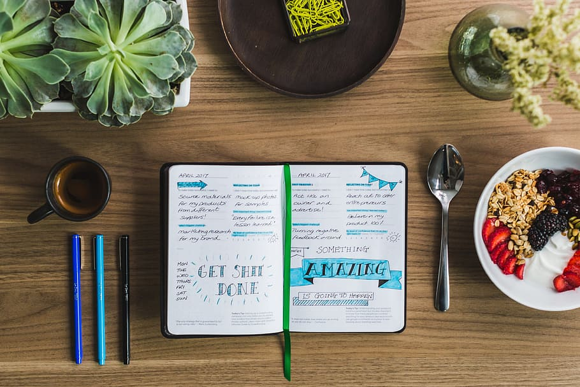
DEALING WITH ANXIETY
Stay close to your normal routine - Wake up and go to bed around the same time, eat meals, shower, adapt your exercise regimen, and get out of your PJ’s. Do laundry on Sundays as usual.
Reframe “I am stuck inside” to “I can finally focus on my home and myself”
Start a new quarantine ritual - for example, go for a daily walk, journal your thoughts/feelings, start your house DIY tasks you have been putting off for a while
Use telehealth as an option to talk to a professional if your anxiety becomes unmanageable
How to Manage Anxiety and Isolation During Quarantine
https://adaa.org/learn-from-us/from-the-experts/blog-posts/consumer/covid-19-lockdown-guide-how-manage-anxiety-and

Slide 10
THINGS TO DO WITH YOUR KIDS
Create a timetable: Structure a week for your child that replicates a school week. Set them a timetable with start and end time, with breaks in between.
Work out Together: Try and get children involved with your daily activities.
Encourage Literacy: World Book Online have a fabulous collection of over 3,000 ebooks for children to access at home for FREE.
Use Daily Positive Affirmations: Repeat positive powerful affirmations 3 times out loud together with your children.
Tips On How To Cope With Children During Quarantine
https://www.forbes.com/sites/biancamillercole/2020/03/20/18-tips-on-how-to-cope-with-children-on-quarantine/#6cf26b17e6e8

Slide 11
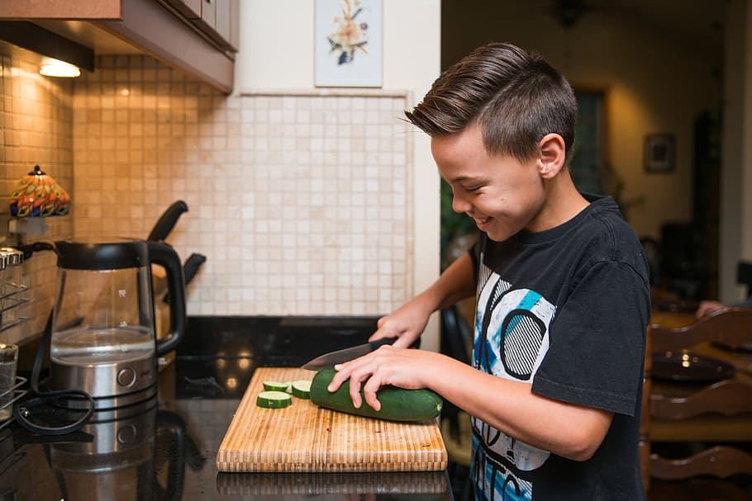
THINGS TO DO WITH YOUR KIDS
Gardening basics: stock up on enough seeds, small plants and soil so you can have plenty gardening projects for your kids. It is also a good way to show them how to be responsible and take care plants.
Cooking: show your kids how to prep and cook their favorite meals. This is a life skill and will also provide quality bonding time with them.
Movie Nights: choosing a specific day of the week to dedicate to a movie night for you and your kids
Activities for you and your kids during quarantine
https://www.latimes.com/lifestyle/story/2020-03-26/10-things-to-do-right-now-inside-with-young-kids

