Slide 1
Self-Care
Activities and practices that you can use on a regular basis to maintain and enhance your short-term and long-term health and well-being.
Clearinghouse on Supervised Visitation

Slide 2
Introduction
Self-care is a term widely used to refer to activities and practices that you engage in on a regular basis to maintain and enhance your short-term and long-term health and well-being.
If you neglect your own needs and forget to nurture yourself, you are in danger of deeper levels of unhappiness, low self-esteem, and feelings of resentment.
Also, if you spend your time only taking care of others, you can be at risk of becoming burned out.

Slide 3
Take Care of Yourself
Taking care of yourself and reducing stress is important for your physical and mental health, which directly affects your children’s well-being.
Recognizing the signs of stress is important so you know how to lessen it. Signs of stress include feeling tired, snapping at family and friends, being indecisive, changes in sleep, changes in appetite, headaches and stomachaches, and not being able to concentrate on tasks.
The next several slides are ideas on how to take care of yourself and lessen your stress.

Slide 4
Regular Exercise
The benefits of regular exercise are:
Relieves stress
Lowers the risk of depression and anxiety
Boosts your immune system
Increases energy
Promotes better sleep
Manages weight
Sets a good example for your children

Slide 5
Eating Healthy
The benefits of eating healthy are:
Improves mood
Controls weight
Combats diseases (heart disease, high blood pressure, ect.)
Boosts energy

Slide 6
Plenty of Sleep
Benefits of good sleep are:
Improves memory and attention
Improves concentration and reaction time
Extends length of life
Benefits your health (lower risk of heart disease, high blood pressure, etc.)
Improves mood

Slide 7
Good Hygiene
The benefits of good hygiene are:
Stops the spread of illness and bacteria
Provides increased confidence at work and in social interactions
Improves mood

Slide 8
Avoid Unhealthy Habits
Avoiding unhealthy habits will keep you healthier and safer.
Unhealthy habits to avoid are:
Excessive drinking
Smoking
Recreational drug use
Risky behaviors

Slide 9
Make Time for Yourself
Ideas for spending time for yourself:
Reading a book
Taking a bath or long shower
Meditating
Watching your favorite television program
By making time each day for yourself, you are:
Taking a mental and emotional vacation
Recharging your energy level
Triggering the relaxation response

Slide 10
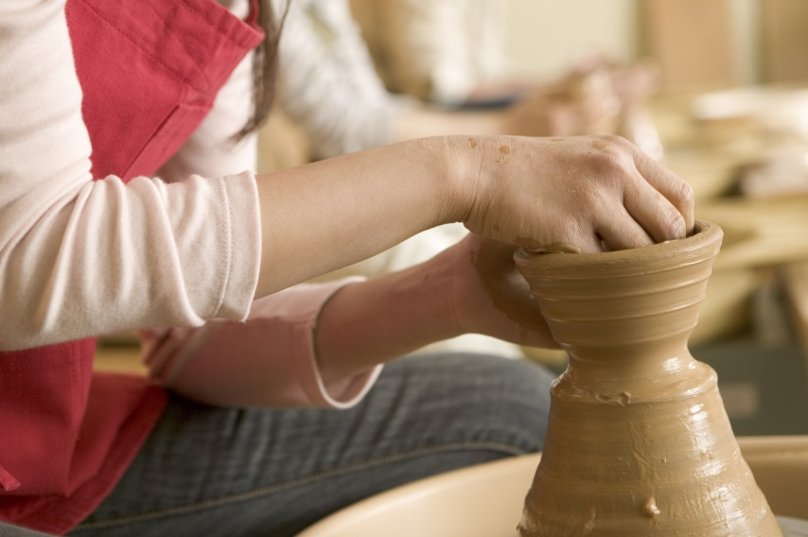
Begin a New Hobby
Beginning a new hobby provides you with an outlet to express yourself, meet others, and enjoy something just for yourself.
Hobbies can include:
Joining a book club
Taking a class
Arts and crafts
Golf or other outdoor sports
Hiking
Playing an instrument

Slide 11
Determine Social Support
Having a positive and helpful support system is crucial to a healthy lifestyle. People who genuinely care about you are invaluable during good times and bad. Your social support can come from a number of different sources such as:
Family
Friends
Support Groups

Slide 12
Social Support Benefits
Research has shown that people with strong support systems have better health, live longer, and report higher well-being.
In addition, your support system will listen to your fears, hopes, and help you feel understood.
They can also provide alternatives to solve problems and help distract you from worries.

Slide 13
Seek Help and Support if Feeling Overwhelmed
You may still feel overwhelmed or stressed regardless if you take care of yourself or have a strong support system.
When you feel overwhelmed, it is good to seek help from professionals.
The next few slides will provide information on who to ask for additional support.

Slide 14
Professional Support: Physicians
If you are feeling sick, achy, or depressed frequently, you may want to see your physician.
A physician can examine you to see if there is something physically wrong with you and give you recommendations to feel better.

Slide 15
Professional Support: Counselors
A counselor can be a good option if you feel like you need to talk to someone with an unbiased view.
They can be a sounding board and also provide therapeutic interventions such as mindfulness, cognitive behavioral therapy, thought restructuring, and meditation.
Counselors can also provide community resources that can be beneficial to you.

Slide 16
Professional Supports: Religion or Spiritual Advisors
If you are religious or spiritual, a religious leader may be a good option to reach out to.
They can provide you support and guidance connected to your religious or spiritual affiliation.

Slide 17
Challenges to Self Care
“Not enough time in the day.”
Feeling selfish for taking time for yourself
Work responsibilities
Not having someone to watch your children
Errands that need to be finished
Children’s school work and activities
Although it can be hard to find time for self-care, routinely doing things for yourself will provide you with more energy.
Try to schedule time each day for yourself.
Even if it is only ten minutes, getting to focus on you can make all the difference.

Slide 18
Conclusion
Self-care is crucial to keep yourself healthy and to be an active parent in your child’s life.
It can be difficult to find time, but there are ways to focus on yourself and there are resources available to help you along the way.
Remember, self-care involves activities and practices that you engage in on a regular basis to maintain and enhance your short-term and long-term health and well-being.
When you are healthy and free of stress, you will be a more attentive parent and good role model to your children.

